Slide 1

Compiler Design
Preet Kanwal
Department of Computer Science & Engineering
Teaching Assistant : Lavitra Kshitij Madan

Slide 2

Compiler Design
Unit 1
The Phases of a Compiler
Preet Kanwal
Department of Computer Science & Engineering

Slide 3
Compiler Design Lecture Overview
In this lecture, you will practise:
C Language Grammar
Running an input through the different phases of a compiler

Slide 4
Compiler Design Example 2
Example 2 : Consider the following piece of code:
int rhs, lhs = 0; rhs = 2;
if (lhs <= rhs)
{
lhs = lhs – 2 * rhs;
}
We will now run this code through the different phases of a compiler and see what the output will be at each stage.

Slide 5
Compiler Design Example 2 (continued)
Phase 1 : Lexical Analysis or Linear Analysis or Scanner
Pattern | Lexemes matched
Keyword | int if
Identifier | rhs |  | lhs rhs |  | lhs |  | rhs | lhs | lhs | rhs
RelOp (<, <=, >, >=, ==, !=) | <=
LogOp (&&, ||, ~)
Assign (=) | = | = | =
ArithOp (*, +, -, /) | - *
Punctuation ( (, ), {, }, [, ], ;) | ; | ; | ( ) | { | ; | }
Number | 0 | 2 | 2
Literal – anything in double quotes
Inc_op
Dec_op
int rhs, lhs = 0;
rhs = 2;
if (lhs <= rhs)
{
lhs = lhs – 2 * rhs;
}

Slide 6
Compiler Design Example 2 (continued)
Output: # of tokens : 27
< keyword, int >
< ID, 3 >
< punctuation, , >
< ID, 4 >
< Assign, = >
< Number, #0 >
< punctuation, ; >
< ID, 3 >
< Assign, = >
< Number, #2 >
< punctuation, ; >
< keyword, if >
< punctuation, ( >
< ID, 4 >
< RelOp, <= >
< ID, 3 >
< punctuation, ) >
Symbol Table
 | name | type | …
1 | …
2 | ….
3 | rhs
4 | lhs
int rhs, lhs = 0;
rhs = 2;
< punctuation, { >
< ID, 4 >
< Assign, = >
< ID, 4 >
< ArithOp, - >
< Number, #2 >
< ArithOp, * >
< ID, 3 >
< punctuation, ; >
< punctuation, } >
if (lhs <= rhs)
{
lhs = lhs – 2 * rhs;
}

Slide 7
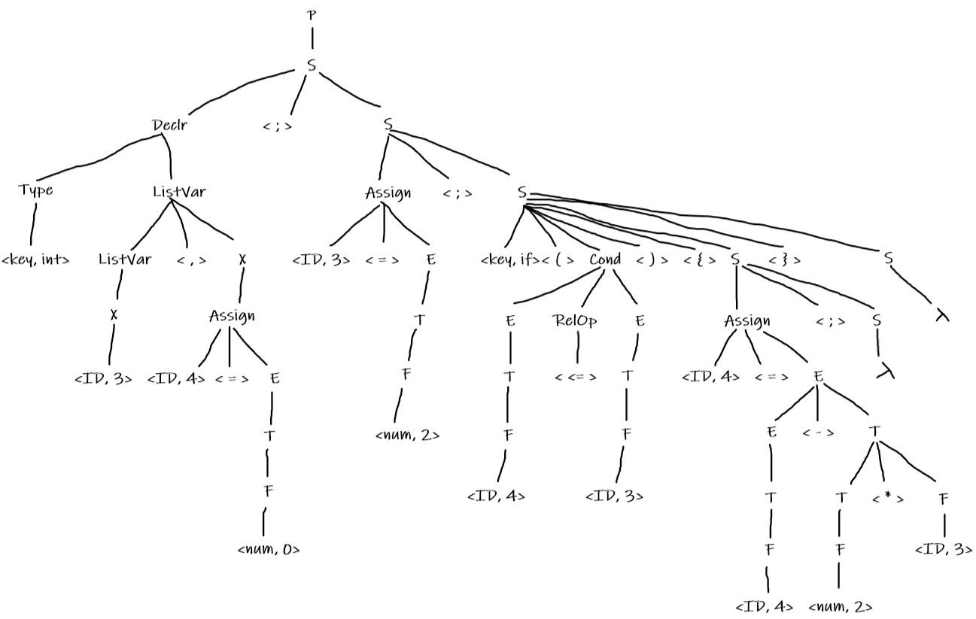
Compiler Design Example 2 (continued)
Phase 2 : Syntax Analysis or Parser
Use the grammar we have defined earlier
int rhs, lhs = 0; rhs = 2;
if (lhs <= rhs)
{
lhs = lhs – 2 * rhs;
}

Slide 8
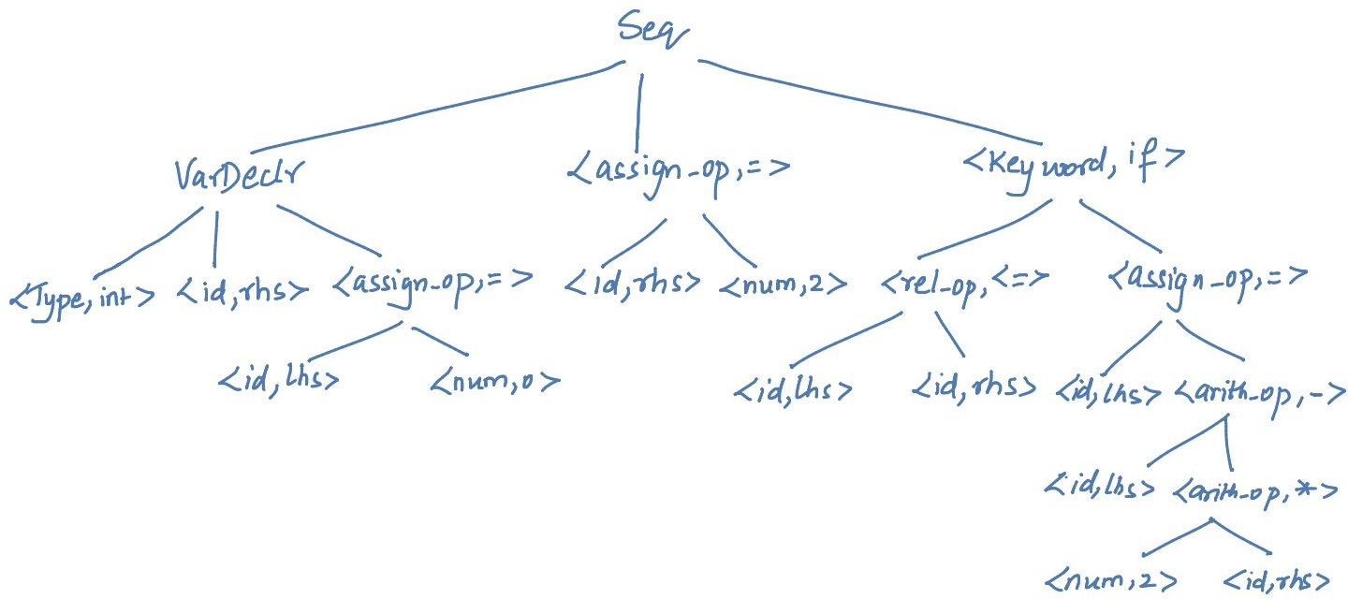
Compiler Design Example 2 (continued)
Phase 3 : Semantic Analyzer
Output: Semantically checked Syntax Tree
int rhs, lhs = 0;
rhs = 2;
if (lhs <= rhs)
{
lhs = lhs – 2 * rhs;
}

Slide 9
Compiler Design Example 2 (continued)
Phase 4 : Intermediate Code Generator Output: Three Address Code (3AC or TAC)
lhs = 0
rhs = 2
t0 = lhs <= rhs if t0 goto L1 goto L2
L1 : t1 = 2 * rhs t2 = lhs - t1 lhs = t2
L2 : next
int rhs, lhs = 0;
rhs = 2;
if (lhs <= rhs)
{
lhs = lhs – 2 * rhs;
}

Slide 10
Compiler Design Example 2 (continued)
Phase 5 : Machine Independent Code Optimization Output: Optimized IR
lhs = 0
rhs = 2
t0 = lhs <= rhs if t0 goto L1 goto L2
L1 : t1 = 2 * rhs lhs = lhs - t1
L2 : next
– t2, lhs
int rhs, lhs = 0;
rhs = 2;
lhs
if (lhs <= rhs)
* t1
{
lhs = lhs – 2 * rhs;
2
rhs
}

Slide 11
Compiler Design Example 2 (continued)
Phase 6 : Code Generator Output: Assembly Code
MOV R1, #0
ST lhs, R1 MOV R2, #2
ST rhs, R2
SUB R3, R2, R1 BLTZ R3, L2
LD R4, #2 MUL R4, R2
SUB R5, R1, R4
ST lhs,R5 L2 : ….
lhs = 0
rhs = 2
t0 = lhs <= rhs if t0 goto L1 goto L2
L1 : t1 = 2 * rhs lhs = lhs - t1
L2 : next
int rhs, lhs = 0;
rhs = 2;
if (lhs <= rhs)
{
lhs = lhs – 2 * rhs;
}

Slide 12
Compiler Design Example 3
Example 3 : Consider the following piece of code:
n = 23;
for (i = 0; i < n; i++)
{
sum = sum * i;
}
We will now run this code through the different phases of a compiler and see what the output will be at each stage.

Slide 13
Compiler Design Example 3 (continued)
Phase 1 : Lexical Analysis or Linear Analysis or Scanner
Pattern | Lexemes matched
Keyword | for
Identifier | n | i i | n |  | i |  | printf |  | sum sum i
RelOp (<, <=, >, >=, ==, !=) | <
LogOp (&&, ||, ~)
Assign (=) | = | = =
ArithOp (*, +, -, /) | *
Punctuation ( (, ), {, }, [, ], ;) | ; | ( ; | ; | ) | { |  | ; | }
Number | 23 | 0
Literal – anything in double quotes
Inc_op | ++
Dec_op
n = 23;
for (i = 0; i < n; i++)
{
sum = sum * i;
}

Slide 14
Compiler Design Example 3 (continued)
Output: # of tokens : 25
< ID, 1 >
< = >
< Number, 23 >
< Keyword, for >
< ( >
< ID, 2 >
<assign_op, =>
< Number, 0 >
< ; >
< ID, 2 >
< < >
< ID, 1 >
< ; >
< ID, 2 >
< Inc_op, ++ >
< ) >
Symbol Table
 | name | type | …
1 | n
2 | i
3 | sum
 | …
n = 23;
< { >
<ID, 3>
<assign_op, =>
<ID, 3>
<arith_op, *>
<ID, 2>
< ; >
< } >
for (i = 0; i < n; i++)
{
sum = sum * i;
}

Slide 15
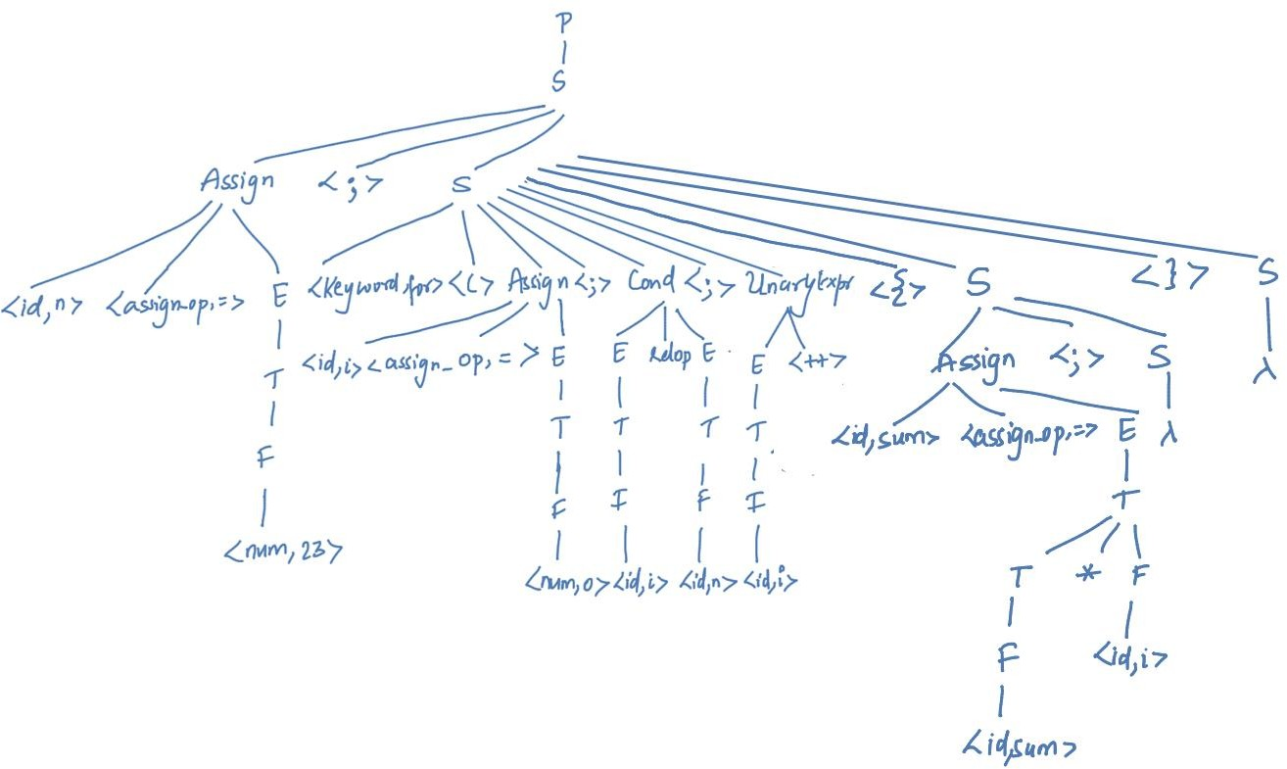
Compiler Design Example 3 (continued)
Phase 2 : Syntax Analysis or Parser
Assume slightly modified grammar (with functions)
n = 23;
for (i = 0; i < n; i++)
{
sum = sum * i;
}

Slide 16
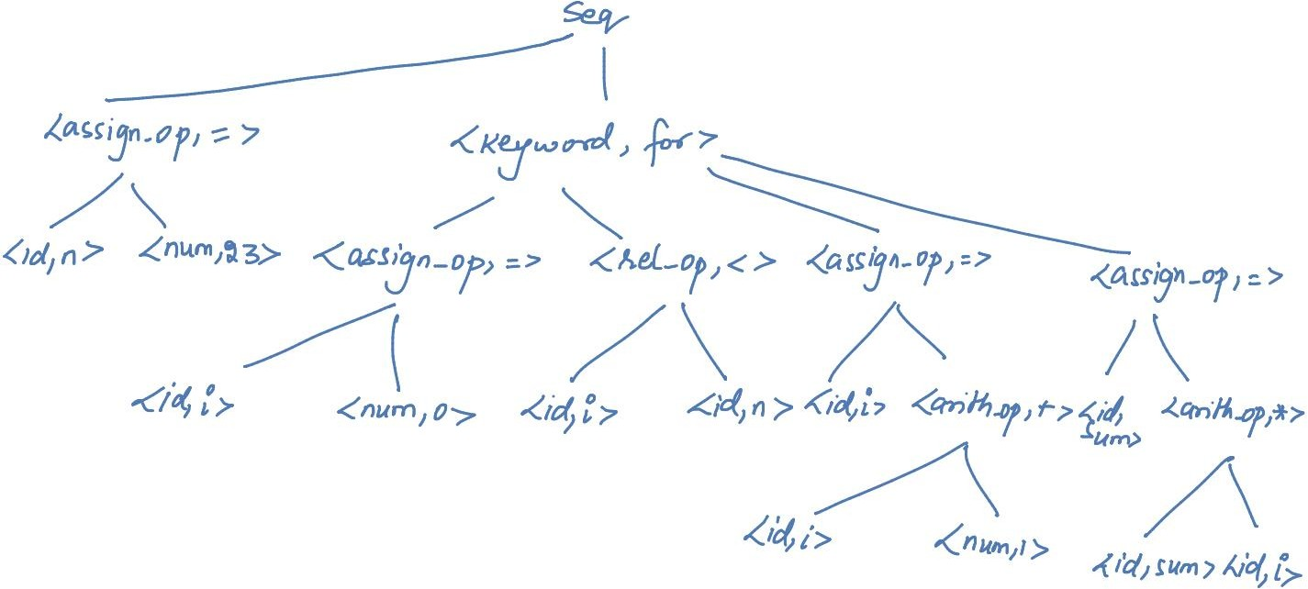
Compiler Design Example 3 (continued)
Phase 3 : Semantic Analyzer
Output: Semantically checked Syntax Tree
n = 23;
for (i = 0; i < n; i++)
{
sum = sum * i;
}

Slide 17
Compiler Design Example 3 (continued)
Phase 4 : Intermediate Code Generator Output: Three Address Code (3AC or TAC)
number = 23
i = 0
L0 : If i < n goto L1
goto L2
L1 : t1 = sum * i sum = t1
t2 = i + 1 i = t2 goto L0 L2 : …
n = 23;
for (i = 0; i < n; i++)
{
sum = sum * i;
}

Slide 18
Compiler Design Example 3 (continued)
Phase 5 : Machine Independent Code Optimization
Output: Optimized IR
number = 23
i = 0
L0 : If i < n goto L1
goto L2
L1 : sum = sum * i i = i + 1
goto L0 L2 : …
n = 23;
for (i = 0; i < n; i++)
{
sum = sum * i;
}

Slide 19
Compiler Design Example 3 (continued)
Phase 6 : Code Generator Output: Assembly Code
number = 23
i = 0
L0 : If i < n goto L1
goto L2
L1 : sum = sum * i i = i + 1
goto L0 L2 : …
MOV R1, #23 // R1 → n MOV R2, #0 // R2 → i
MOV R4, sum // R4 = contents(sum) L0 : SUB R3, R1, R2
BLTZ R3, L2
MUL R4, R4, R2
A DD R 2 , R2 , ,# 1
BR L0
L2: …
n = 23;
for (i = 0; i < n; i++)
{
sum = sum * i;
}

Slide 20
Compiler Design Example 3
Example 3 : Consider the following piece of code:
n = 23;
for (i = 0; i < n; i++)
{
printf(“%c”, 65+i);
}
We will now run this code through the different phases of a compiler and see what the output will be at each stage.

Slide 21
Compiler Design Example 3 (continued)
Phase 1 : Lexical Analysis or Linear Analysis or Scanner
Pattern | Lexemes matched
Keyword | for
Identifier | n | i i | n |  | i |  | printf |  | i
RelOp (<, <=, >, >=, ==, !=) | <
LogOp (&&, ||, ~)
Assign (=) | = | =
ArithOp (*, +, -, /) | +
Punctuation ( (, ), {, }, [, ], ;) | ; | ( ; | ; | ) | { |  | ; | }
Number | 23 | 0 | 65
Literal – anything in double quotes | “%c”
Inc_op | ++
Dec_op
n = 23;
for (i = 0; i < n; i++)
{
printf(“%c”, 65+i);
}

Slide 22
Compiler Design Example 3 (continued)
Output: tokens
< ID, 1 >
< = >
< Number, 23 >
< Keyword, for >
< ( >
< ID, 2 >
< = >
< Number, 0 >
< ; >
< ID, 2 >
< < >
< ID, 1 >
< ; >
< ID, 2 >
< ++ >
< ) >
< { >
< ID, 3 >
< ( >
< Literal, “%c” >
< , >
< Number, 65 >
< + >
< ID, 2 >
< ) >
< ; >
< } >
n = 23;
for (i = 0; i < n; i++)
{
printf(“%c”, 65+i);
}

Slide 23
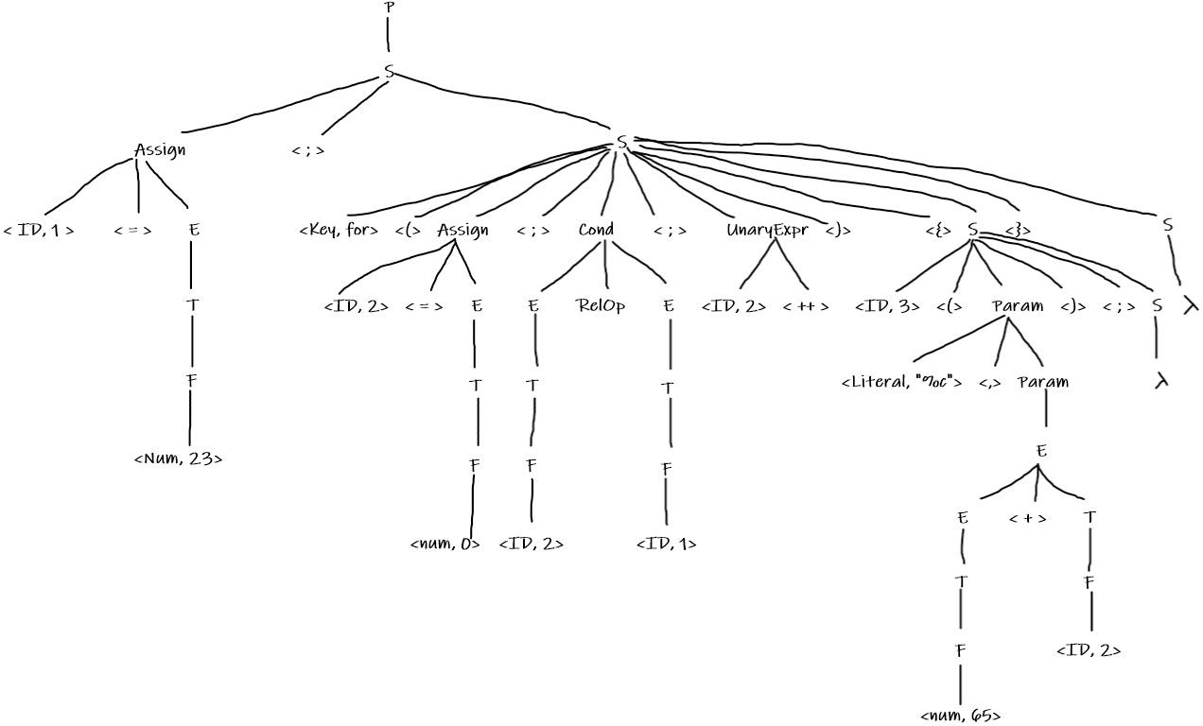
Compiler Design Example 3 (continued)
Phase 2 : Syntax Analysis or Parser
Assume slightly modified grammar (with functions)
n = 23;
for (i = 0; i < n; i++)
{
printf(“%c”, 65+i);
}
S -> id ( Param ); S Param -> E, Param | E |
Literal, Param | Literal

Slide 24
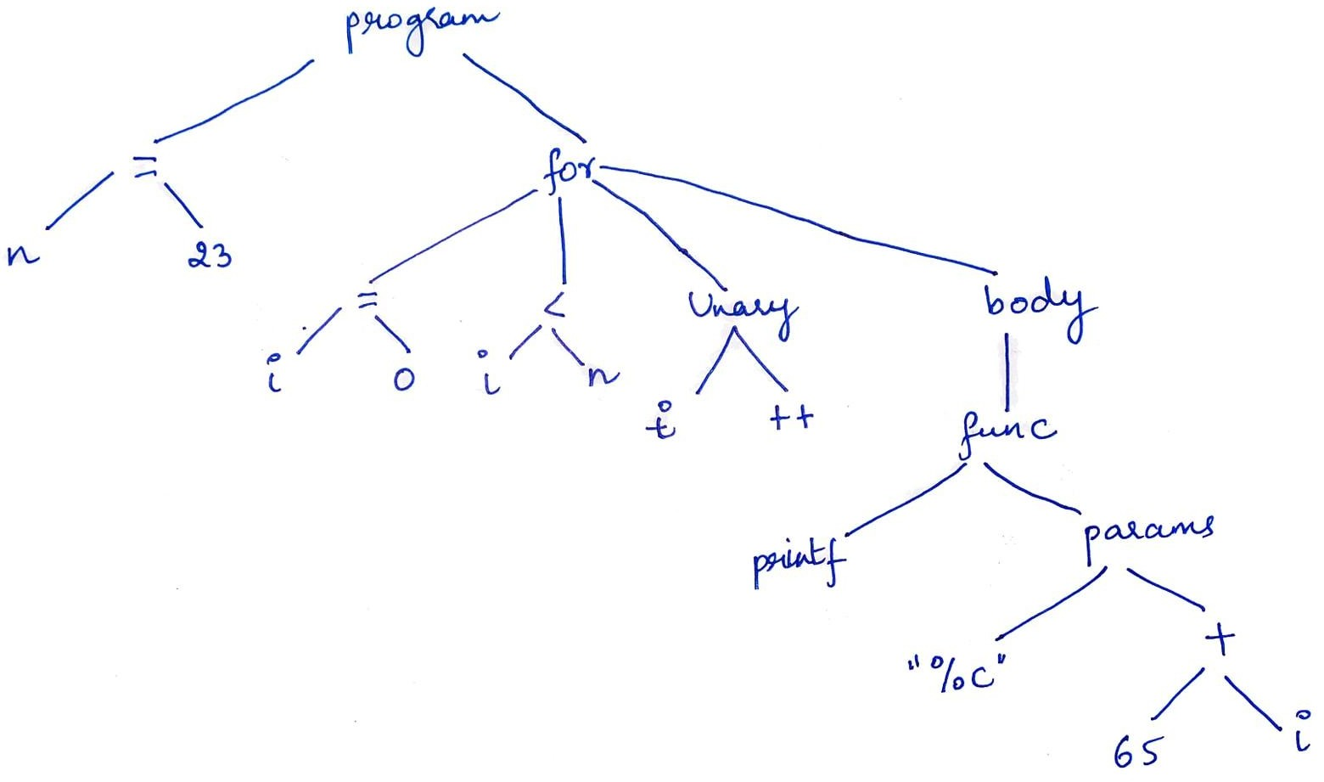
Compiler Design Example 3 (continued)
Phase 3 : Semantic Analyzer
Output: Semantically checked Syntax Tree
n = 23;
for (i = 0; i < n; i++)
{
printf(“%c”, 65+i);
}

Slide 25
Compiler Design Example 3 (continued)
Phase 4 : Intermediate Code Generator Output: Three Address Code (3AC or TAC)
n = 23
i = 0
L0 : If i < n goto L1
goto L2
L1 : t1 = 65 + i
call (printf, t1) t2 = i + 1
i = t2 goto L0 L2 : …
n = 23;
for (i = 0; i < n; i++)
{
printf(“%c”, 65+i);
}

Slide 26
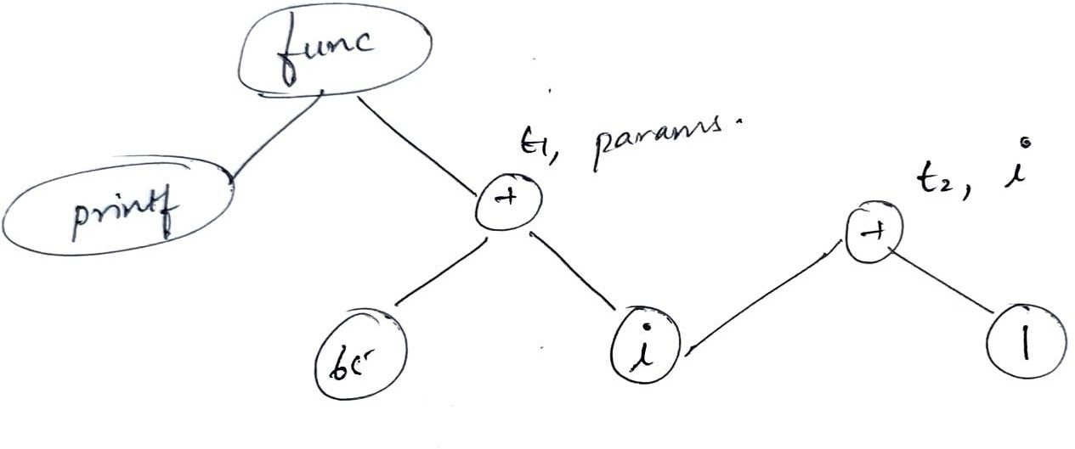
Compiler Design Example 3 (continued)
Phase 5 : Machine Independent Code Optimization
Output: DAG Optimization
n = 23
i = 0
L0 : If i < n goto L1
goto L2
L1 : t1 = 65 + i
call (printf, t1) i = i + 1
goto L0 L2 : …
n = 23;
for (i = 0; i < n; i++)
{
printf(“%c”, 65+i);
}

Slide 27
Compiler Design Example 3 (continued)
Phase 6 : Code Generator Output: Assembly Code
n = 23
i = 0
L0 : If i < n goto L1
goto L2
L1 : t1 = 65 + i
call (printf, t1) i = i + 1
goto L0 L2 : …
MOV R1, #23
ST n, R1 LD R2, #0 L1 :
SUB R3, R1, R2 BLTZ R3, L2
LD R4, #65 ADD R5, R4, R2 PRINT R5
ADD R2, R2, #1 BR L1
L2: …
n = 23;
for (i = 0; i < n; i++)
{
printf(“%c”, 65+i);
}

Slide 28
Compiler Design
Example 4 - Take home exercise
Exercise Problem : Consider the following piece of code: int n = 3;
do
{
if( (n/2)*2 == n )
{
n = n / 2;
}
else
{
n = 3 * n + 1;
}
}
while(n != 1 || n != 2 || n != 4); return n;
This problem is for the understanding of the concept by testing you on if-else and do-while constructs.
Note: The Parse Tree may become large, try to do the if-else part separately
Hint: Consider
S -> do {S} while (S); S in the grammar

Slide 29
THANK YOU
Preet Kanwal
Department of Computer Science & Engineering
preetkanwal@pes.edu

